Slide 1


AWS Shared Responsibility Model
Customer content
Customers are responsible for their security and compliance IN the Cloud
Platform, Applications, Identity & Access Management
Customers
Operating System, Network & Firewall Configuration
Client-side Data Encryption
Server-side Data Encryption
Network Traffic Protection
AWS Foundation Services
AWS is responsible for the security OF
the Cloud
Compute
Storage
Database
Networking
Availability Zones
AWS Global Infrastructure
Edge Locations
Regions

Slide 2
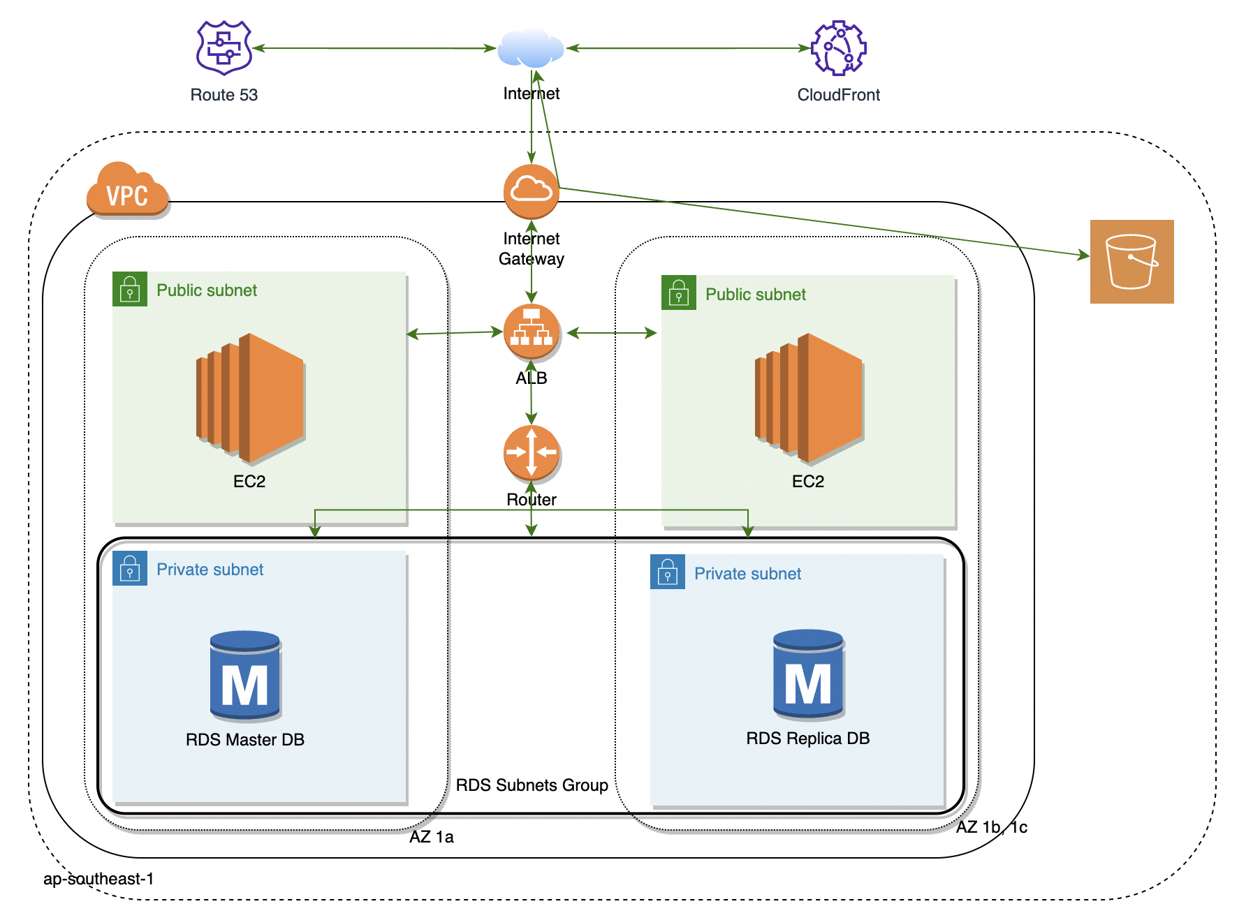
SSA Design and Deployment

Slide 3
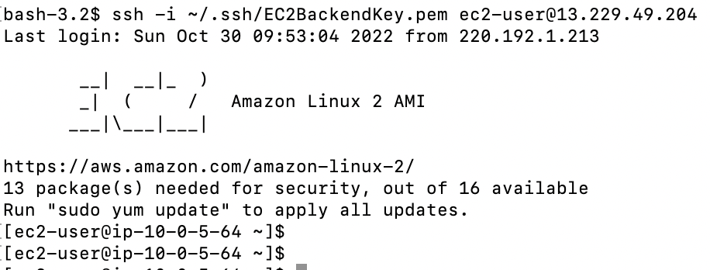
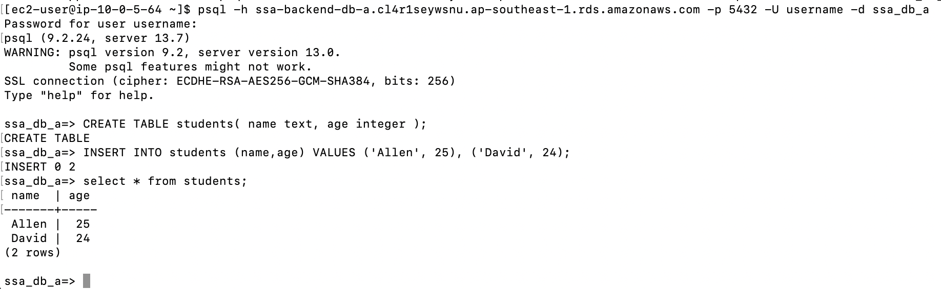
Validation
EC2 SSH connectivity
EC2 to RDS connectivity

Slide 4
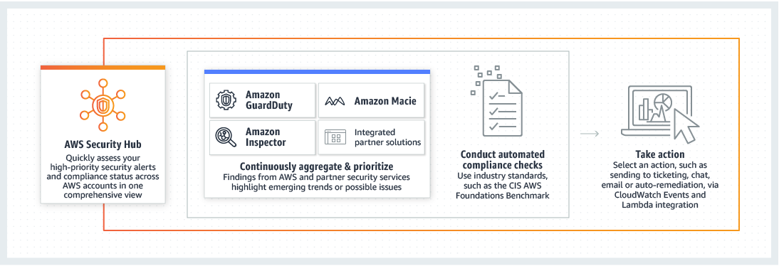

AWS Security Hub Overview

Slide 5




AWS Security Hub Benefits
Managed regional AWS service in minutes that aggregates findings across AWS accounts
Manage security and compliance findings in a single location, increasing efficiency of locating relevant data
Create custom insights to track issues unique to your environment

Slide 6







AWS Security Hub workflow
Account 1
Account 2
Account 3
Enable AWS Security Hub for all your accounts.
Continuously aggregate and prioritize findings.
Conduct automated compliance scans and checks.
Take action based on findings.

Slide 7
AWS Security Hub insights
Security findings that are correlated and grouped for prioritization
More than 20 pre-built insights provided by AWS and AWS partners
Ability to create your own insights
Dashboard provides visibility into the top security findings
Additional details for each finding is available for review
EC2 instances that have
missing security patches
S3 buckets with stored credentials
S3 buckets with public read and write permissions

Slide 8







Use Case: Alert Triage
Status: Yellow
Security findings as custom events
AWS Lambda Function 1
AWS Lambda Function 2
AWS Lambda
…
Amazon CloudWatch
AWS Security Hub
Status: Red
Notify SecOps team with Amazon SNS
Events
Rule
Amazon Simple Notification Service
Customizable response and remediation actions

Slide 9

Use Case: Compliance Scans
An ACL configuration change is discovered by Security Hub –
bucket set to public
1
AWS Security Hub
2
Security Hub invokes Lambda function
Amazon Simple Storage Service (S3)
Lambda function sets bucket ACL back to private
3
AWS Lambda

Slide 10
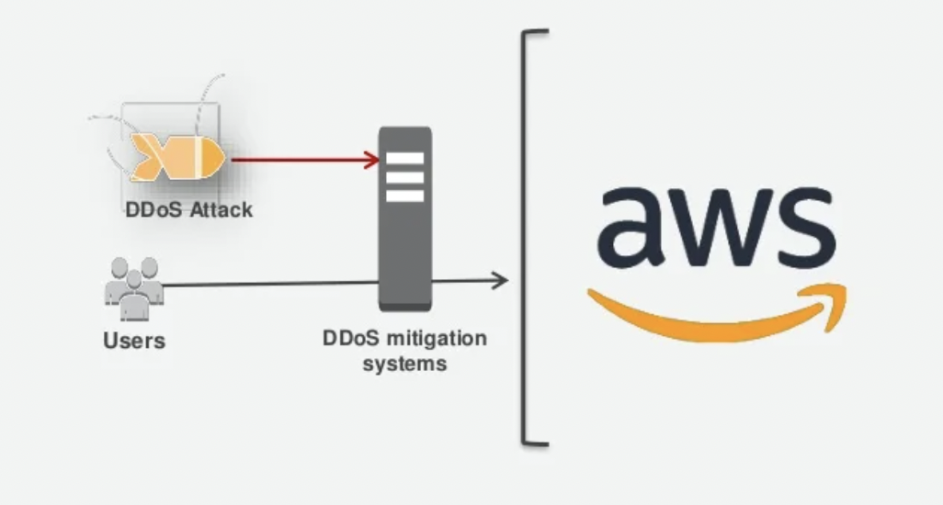
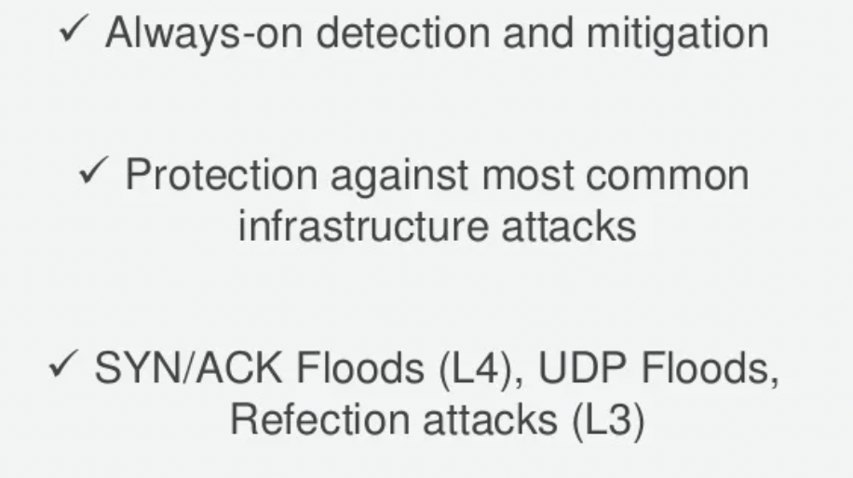
AWS Shield: DDoS protection

Slide 11
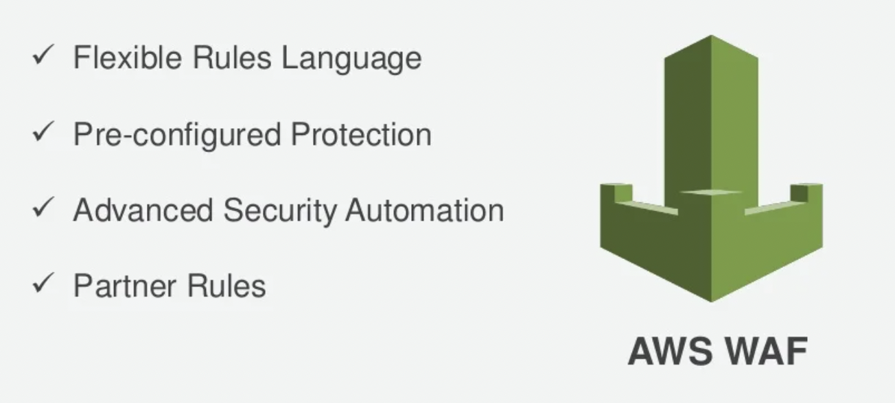
AWS WAF: L7 protection

Slide 12
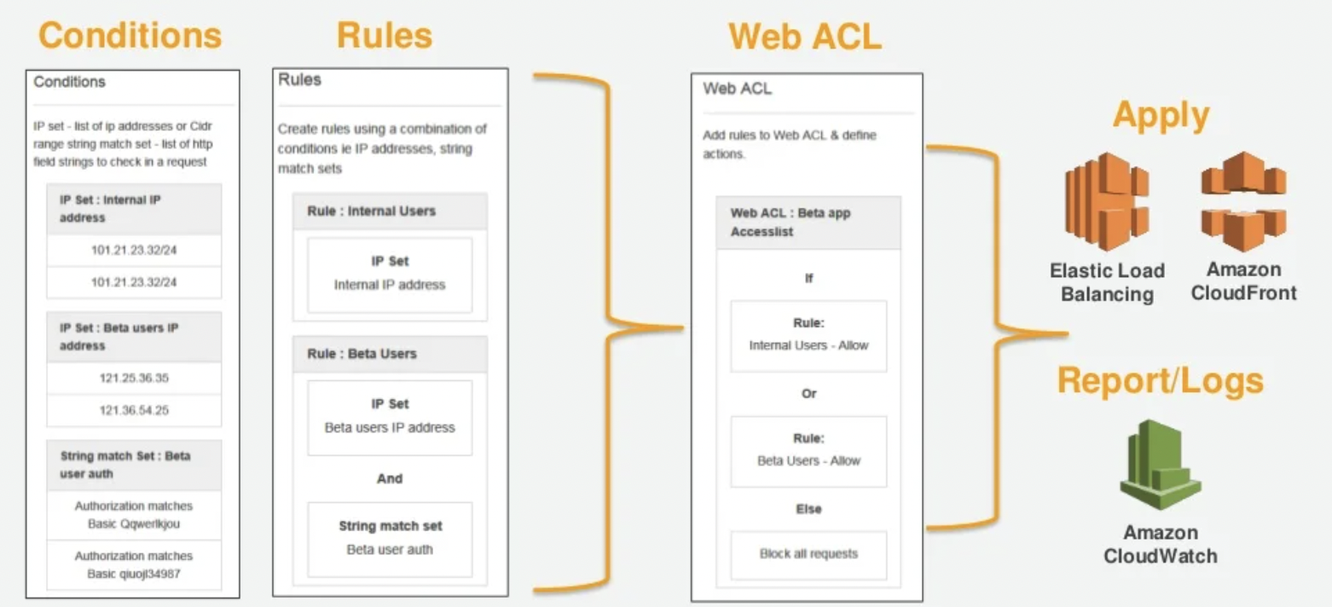
AWS WAF: Component

Slide 13
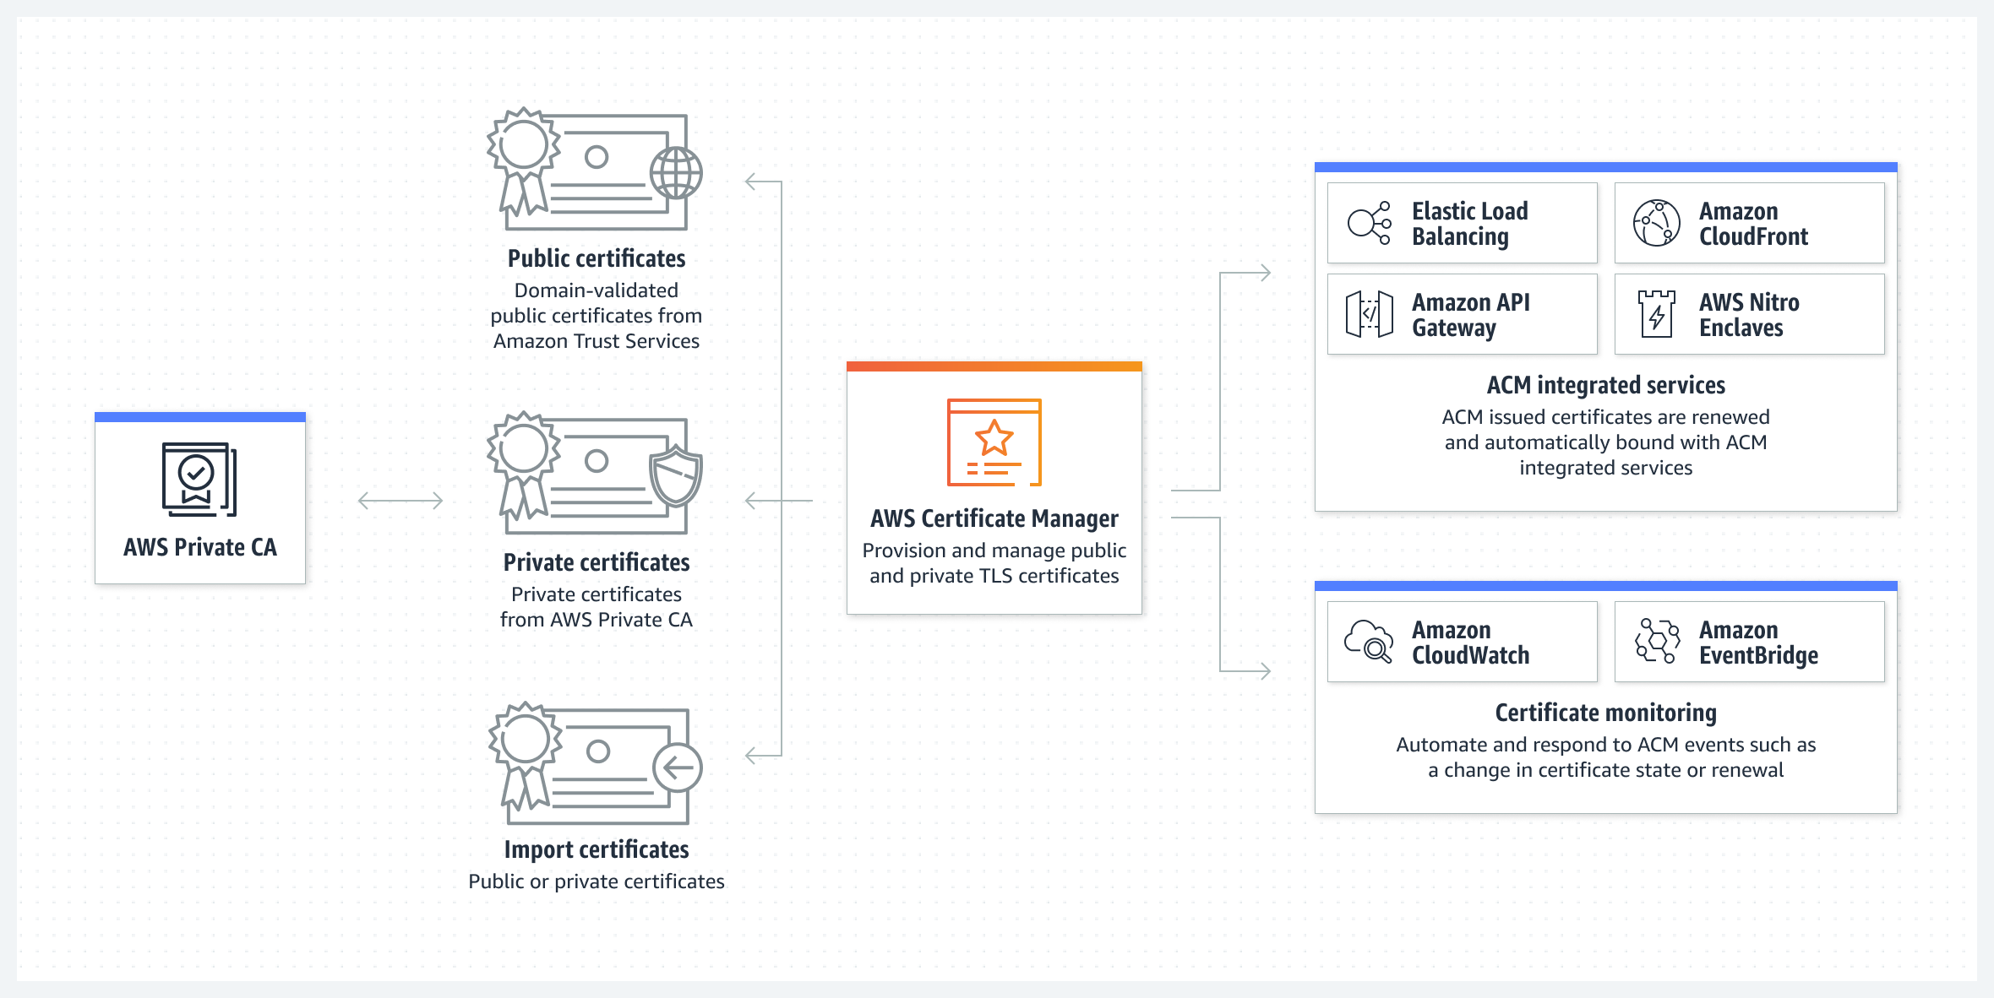
AWS Certificate Manager
Provision and manage SSL/TLS certificates

Slide 14
ACM Lifecycle Management
Provides a single interface to manage both public and private certificate
ACM managed certificates renew and deploy automatically with ACM integrated services
Protects and stores private keys used with certificates via best practices
API hooks to let you export and deploy certificate from your code

Slide 15
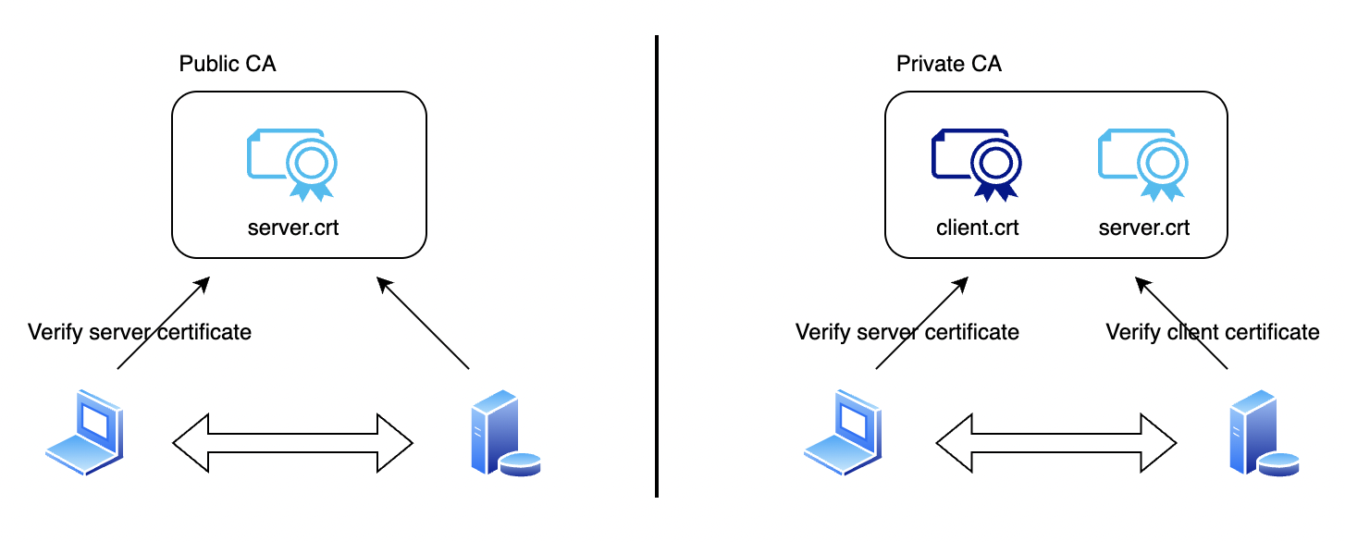
ACM: Public vs. Private CA

Slide 16








Attacker Tactics for Initial Compromise
Unpatched vulnerabilities
Security misconfigurations
Weak, leaked, stolen passwords
Social engineering
Insider threat
AWS Systems Manager
AWS Systems Manager
AWS Secrets Manager
Amazon GuardDuty
Amazon GuardDuty
AWS Marketplace
Amazon Inspector
AWS Marketplace
Amazon Inspector
Guidance
AWS CloudTrail

Slide 17












AWS Security Services Overview
Automate
AWS Systems Manager
Amazon Inspector
Amazon Macie
Amazon GuardDuty
AWS Security Hub
AWS Lambda
Amazon CloudWatch
AWS Config
Detect
Identify
Protect
Respond
Recover
Snapshot
Archive
AWS Key Management Service
AWS Firewall Manager
AWS Shield
Amazon VPC
Investigate
AWS Identity and Access Management (IAM)
AWS Single Sign-On
AWS Secrets Manager
AWS WAF
Amazon CloudWatch
AWS CloudTrail

Slide 18
Core logging services
Amazon CloudWatch
AWS CloudTrail
Full visibility of your AWS environment
CloudTrail will record access to API calls and save logs in your S3 buckets, no matter how those API calls were made
Who did what and when and from where (IP address)
CloudTrail/Config support for many AWS services and growing - includes EC2, EBS, VPC, RDS, IAM and RedShift
Edge/CDN, WAF, ELB,VPC/Network FlowLogs
Easily Aggregate all log information
CloudWatch Alarms

Slide 19




Cyber Data Lake
Amazon EMR
Amazon Athena
Cyber Data Lake
Amazon Elasticsearch Service
AWS Glue
Machine/Deep Learning
On premises activities
Realtime Application and Users activities
AWS Security Services

